Slide 1
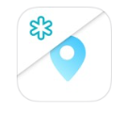
mobileMDSS

Slide 2
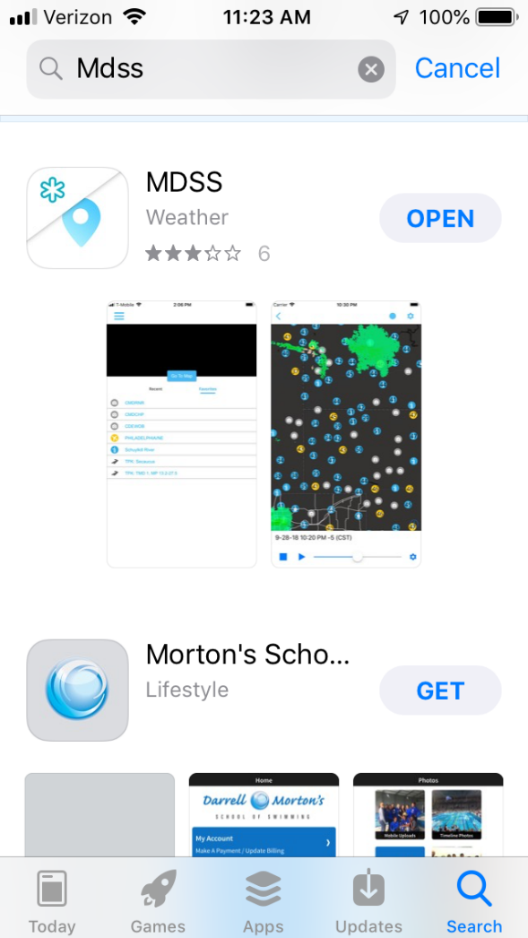
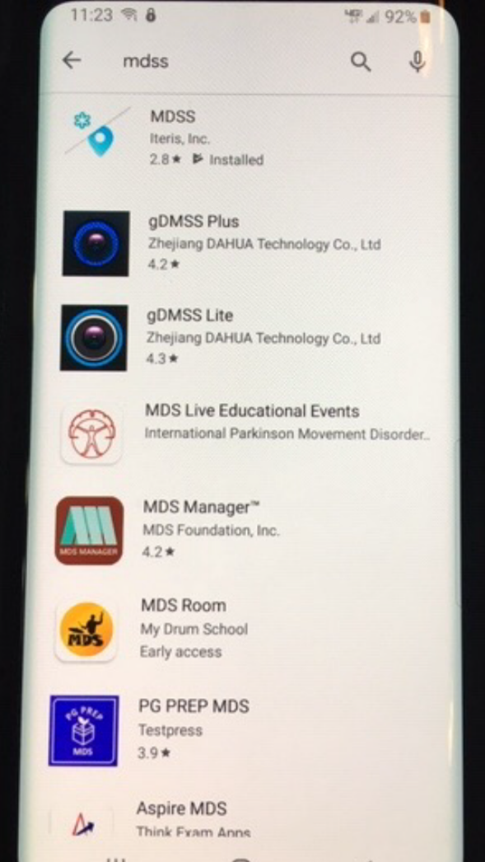
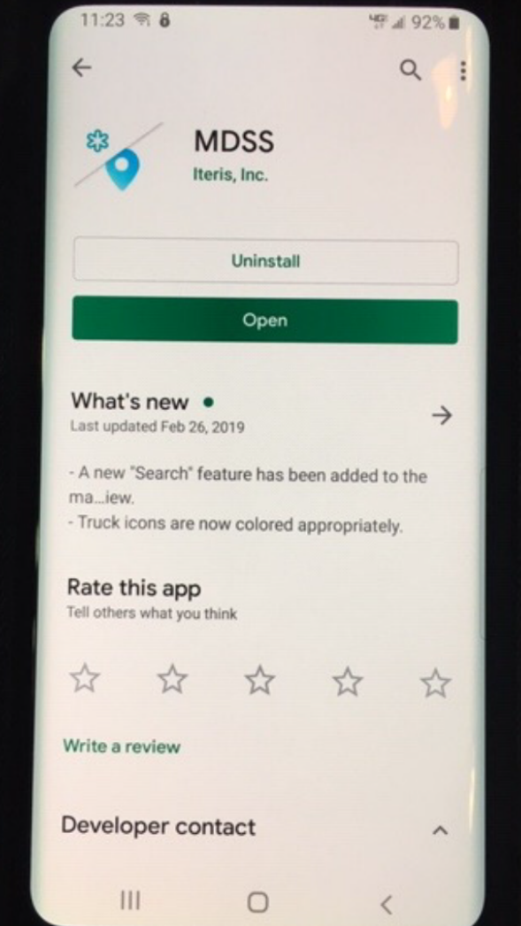
What to look for in the APP Stores

Slide 3
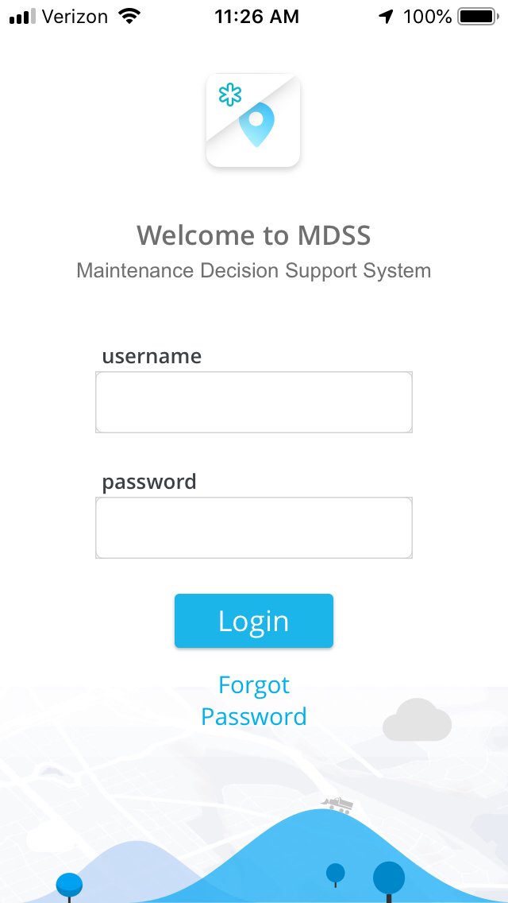
Login Screen
Shop or personal accounts can be used to login
If you do not have a personal account and would like one, contact your RWT Coordinator.

Slide 4
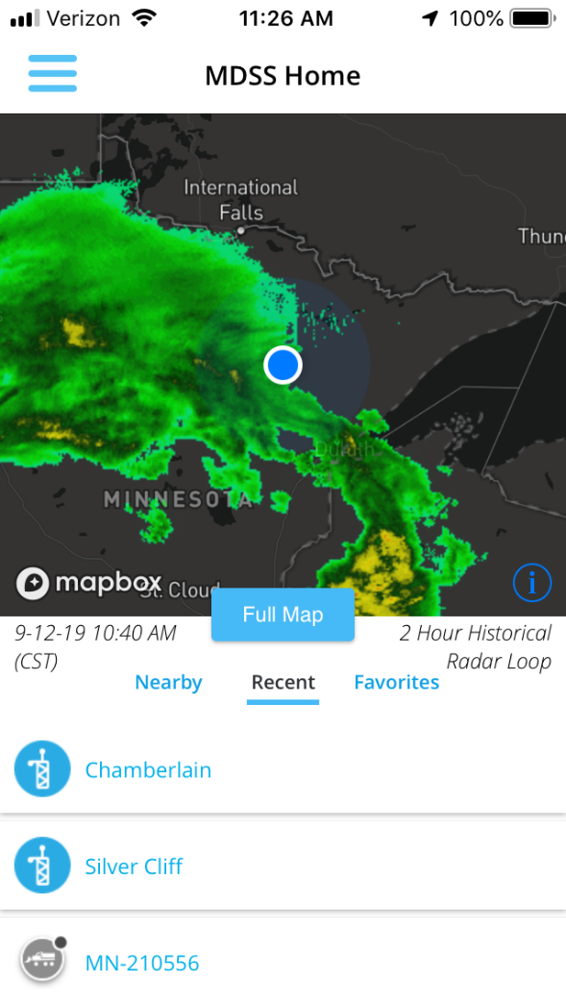
Main Load Screen
Notes:
Discuss the nearby, recent, and favorites option

Slide 5
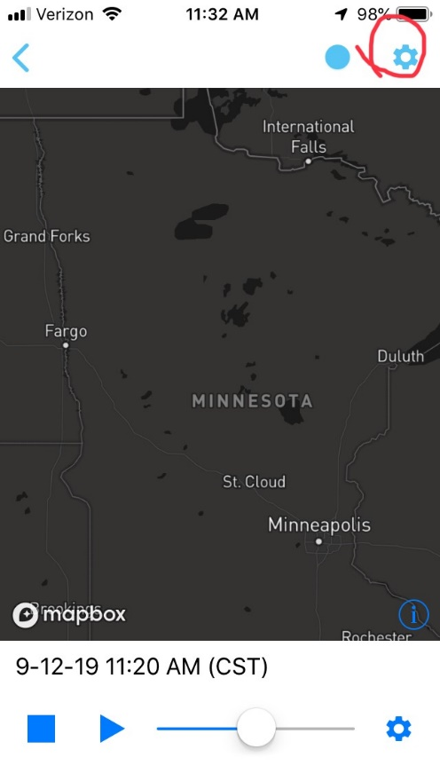
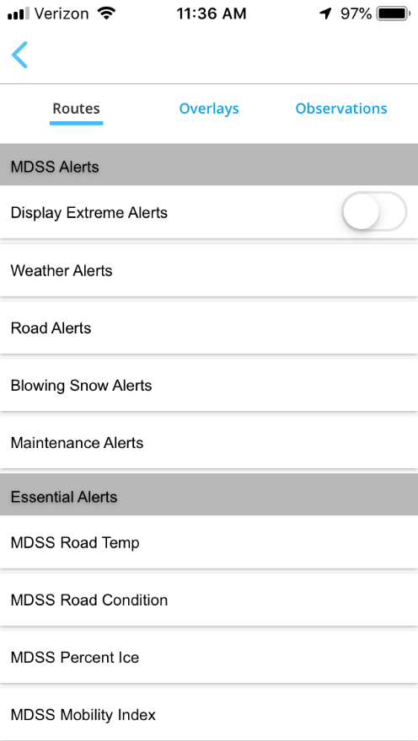
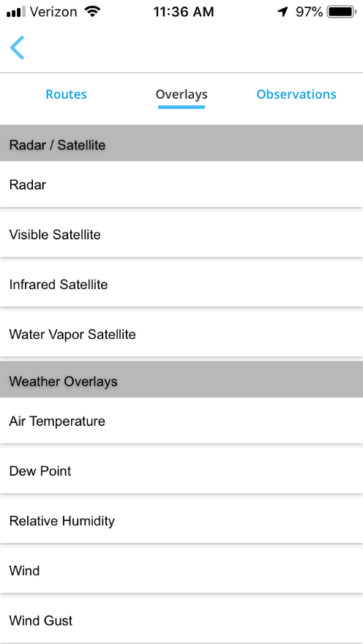
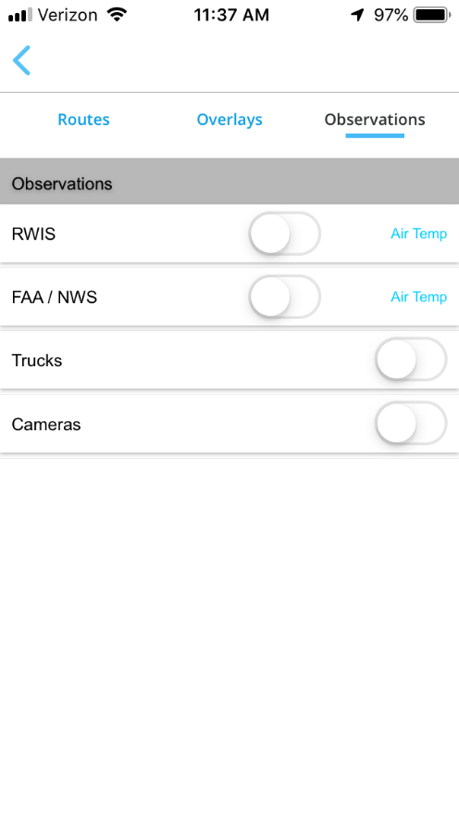
Full Map (Blank)
Notes:
Mention that there are more options to choose from inside the app.

Slide 6
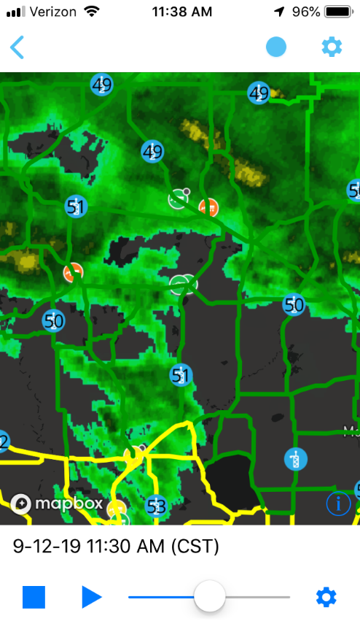
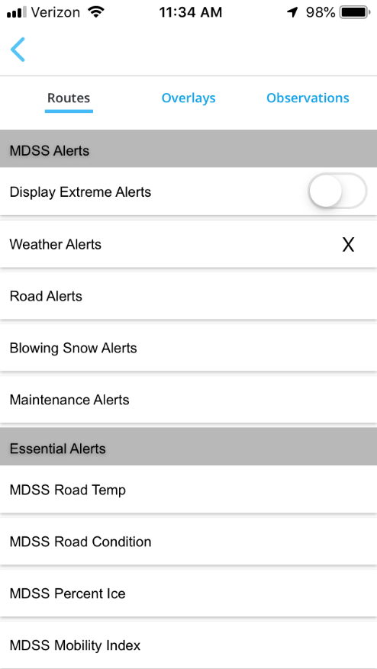
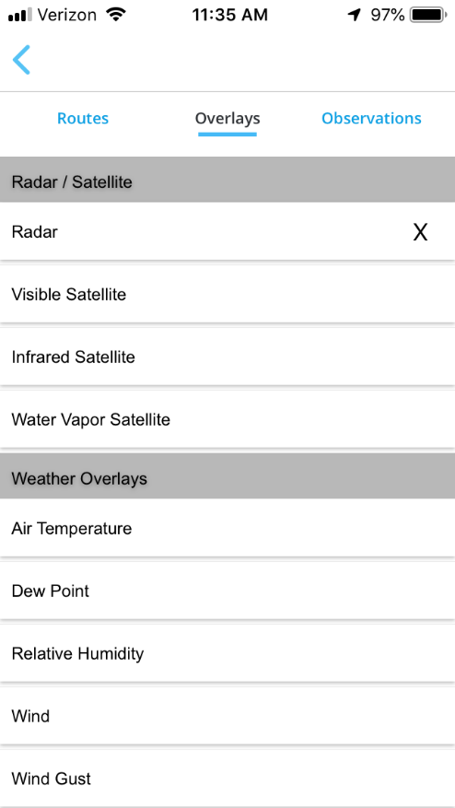
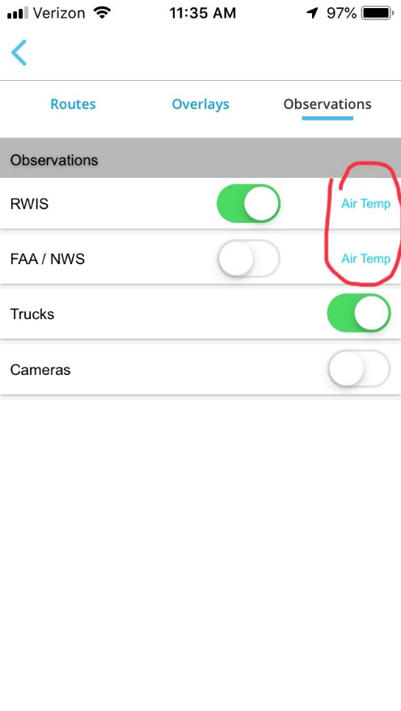
Full Map (With Selections)
Notes:
Mention that under Observations you can select different items to display for RWIS and FAA such as Air Temp, Surface Temp, Weather, Wind Speed, etc…

Slide 7
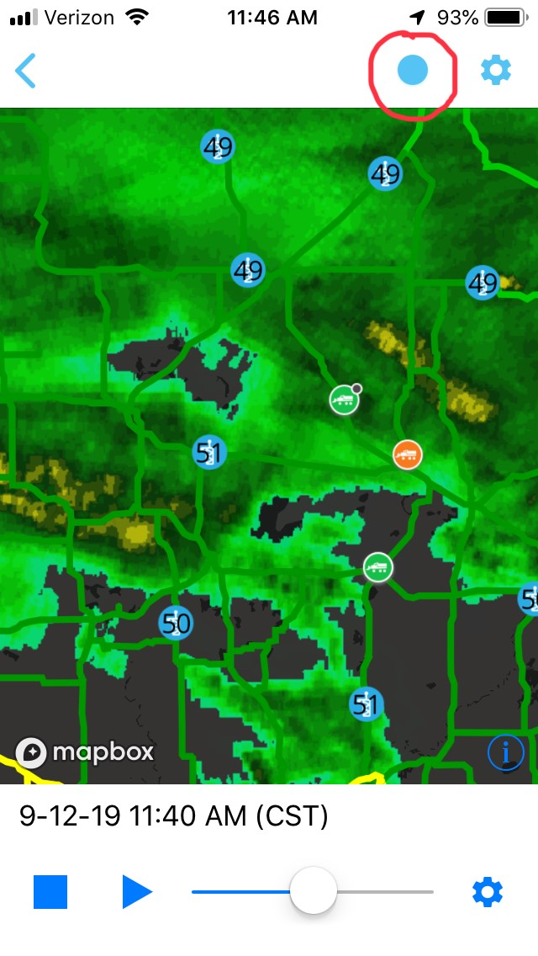
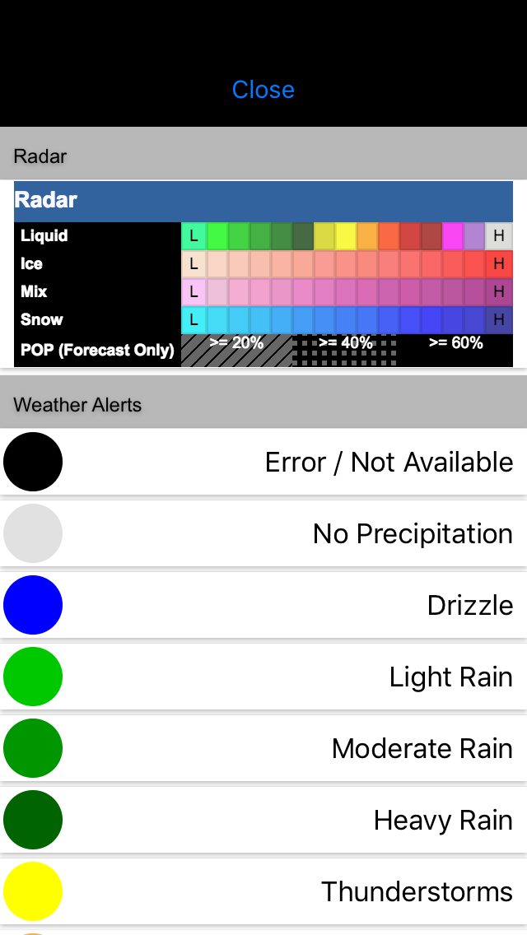
Full Map (Legend)
Notes:
Explain that the there will be a legend for each option that is selected to display on the main screen

Slide 8
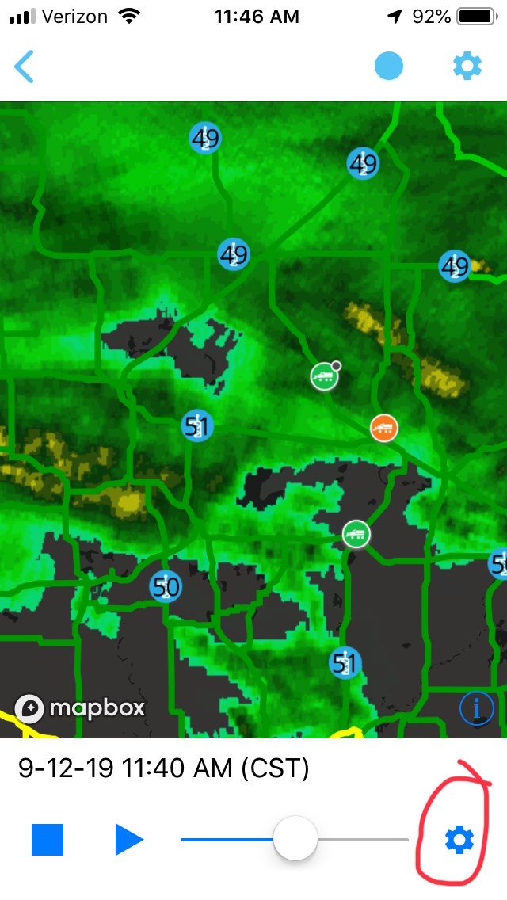
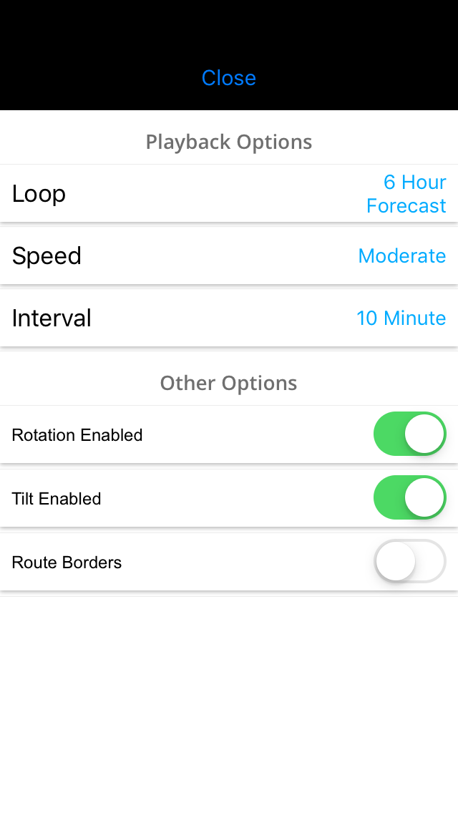
Full Map (Radar Options)
Notes:
Loop Selections 24 HR Historic/Forecast, 6 HR Historic/Forecast, 2 HR Historic/Forecast
Speed: Slow, Moderate, and Fast
Interval: 10 MIN or 1HR

Slide 9

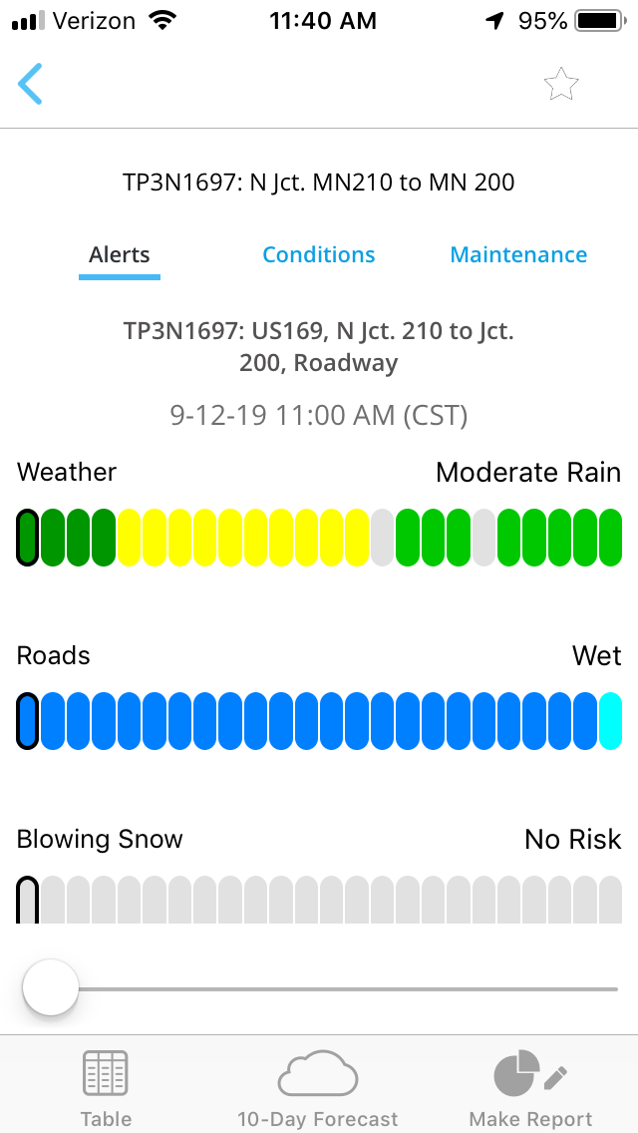
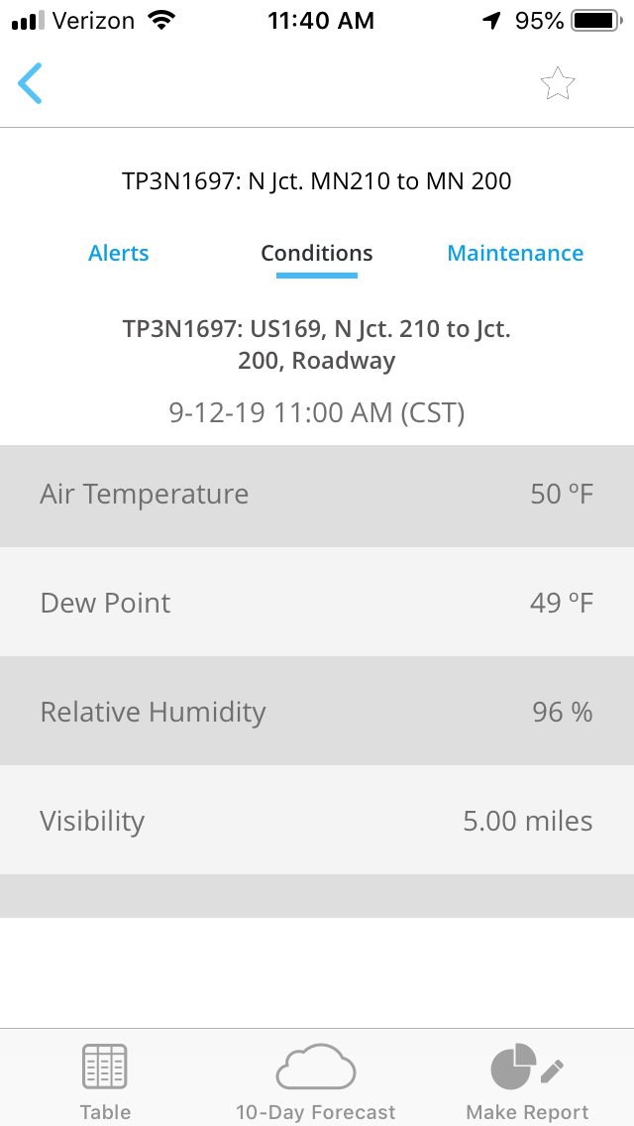
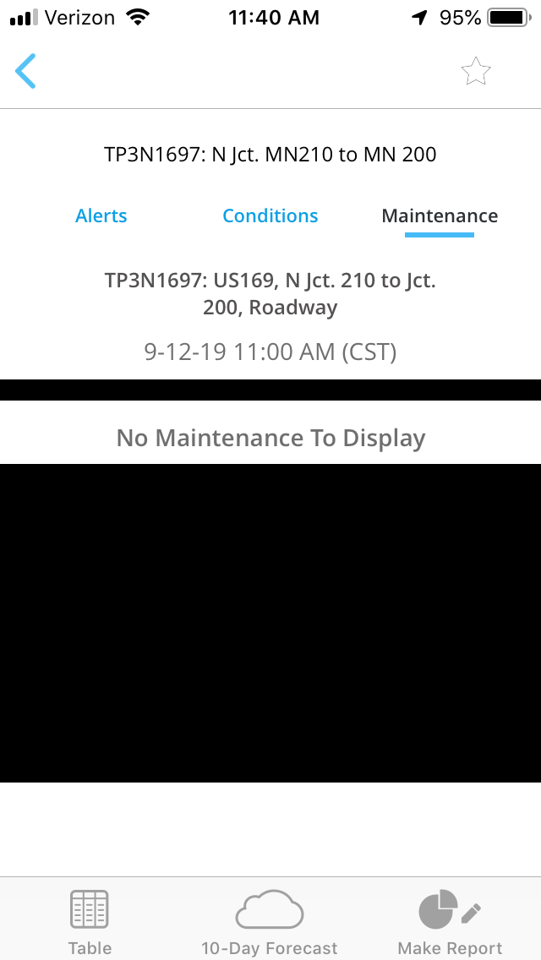
Selecting a route
Notes:
Explain that you use your finger to select the route you want
Explain that taping the STAR in the upper right is how you “Favorite” a route/RWIS

Slide 10
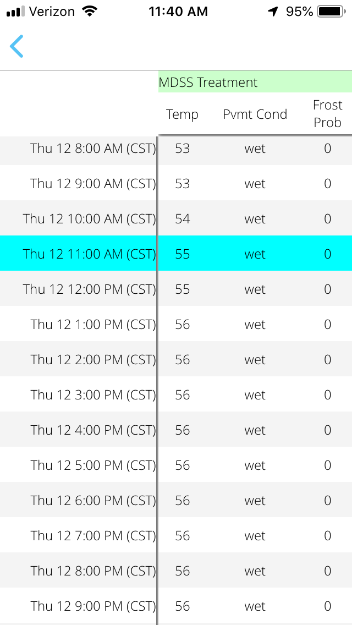
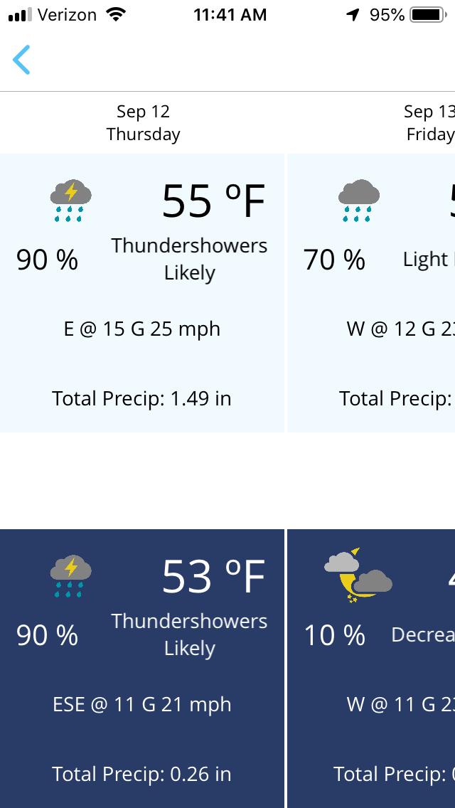
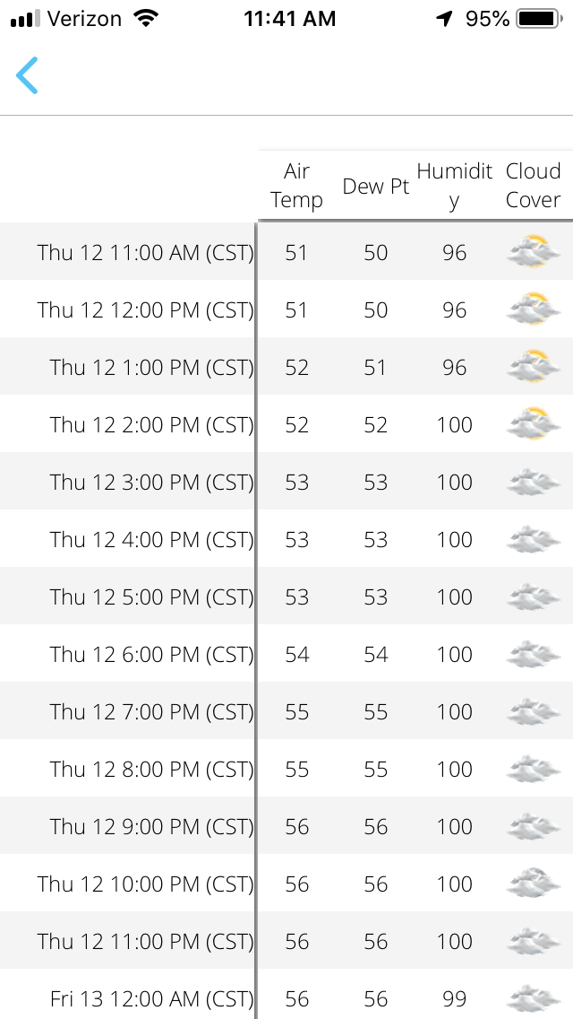
Route Forecasts
Notes:
Explain that to get the Table/10 Day you select them from the bottom of the screen
Explain that you can slide the forecasts up/down and left/right to see more info

Slide 11

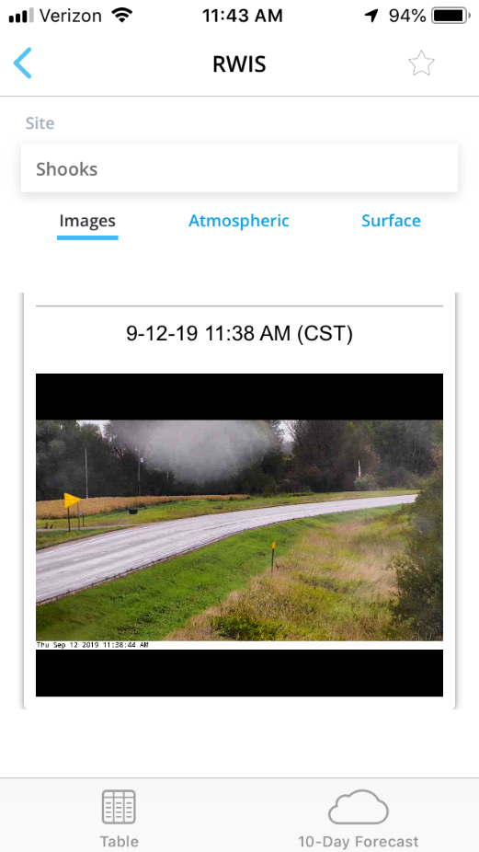
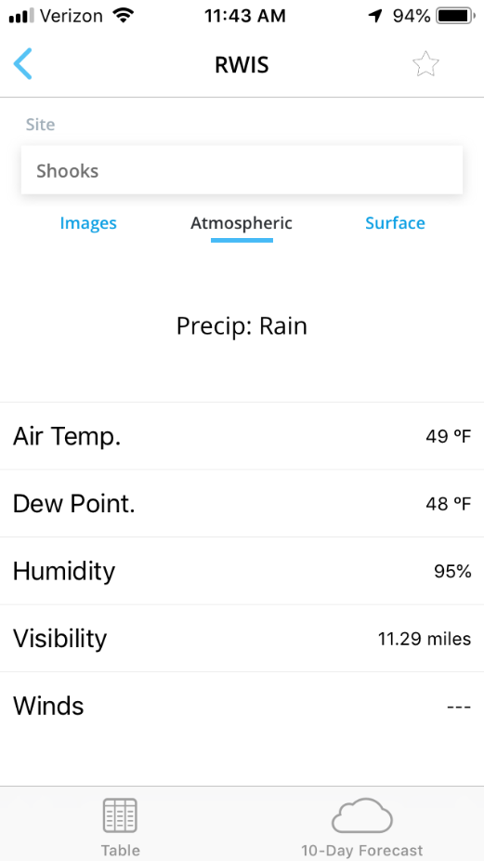
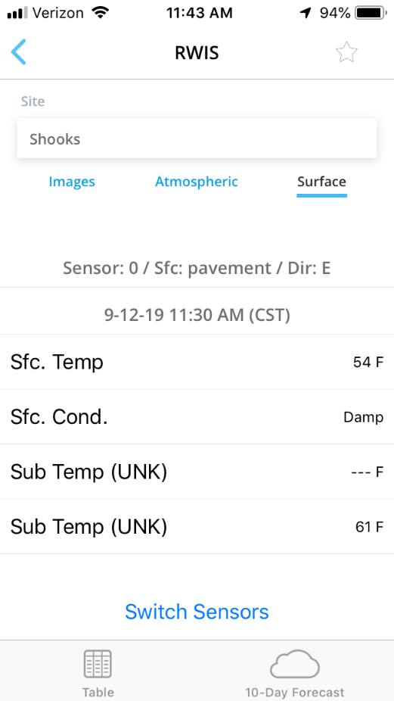
Selecting Observations (RWIS)
Notes:
Explain that to get the Table/10 Day you select them from the bottom of the screen
Explain that you can slide the forecasts up/down and left/right to see more info

Slide 12

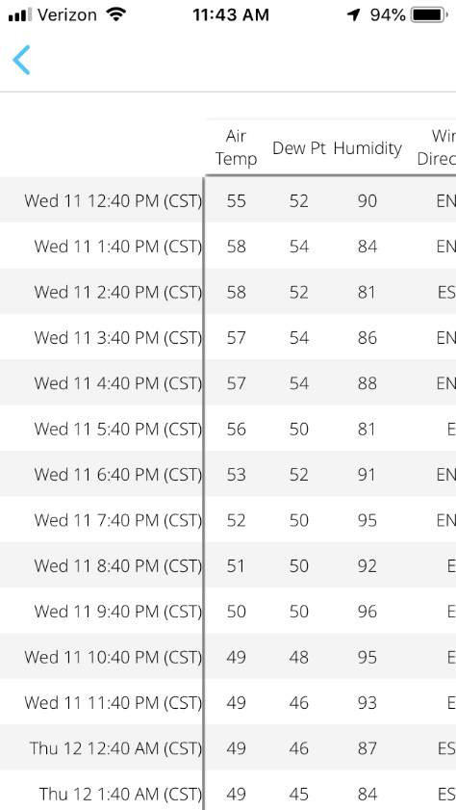
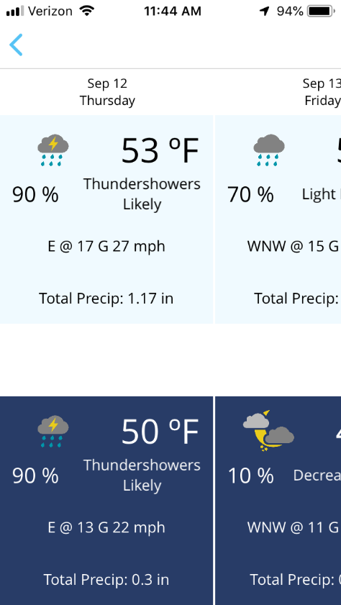
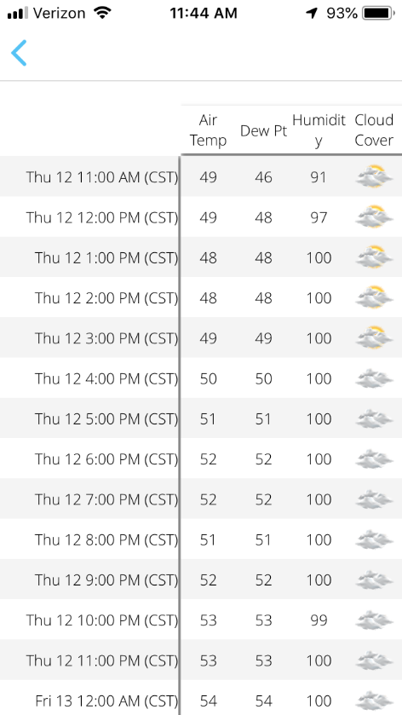
Observation Forecast
Notes:
Explain that to get the Table/10 Day you select them from the bottom of the screen
Explain that you can slide the forecasts up/down and left/right to see more info

Slide 13

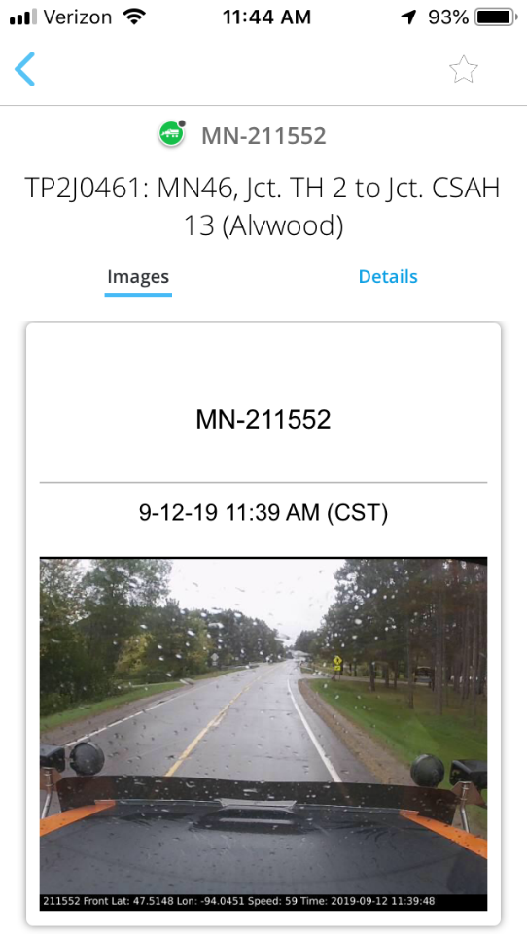
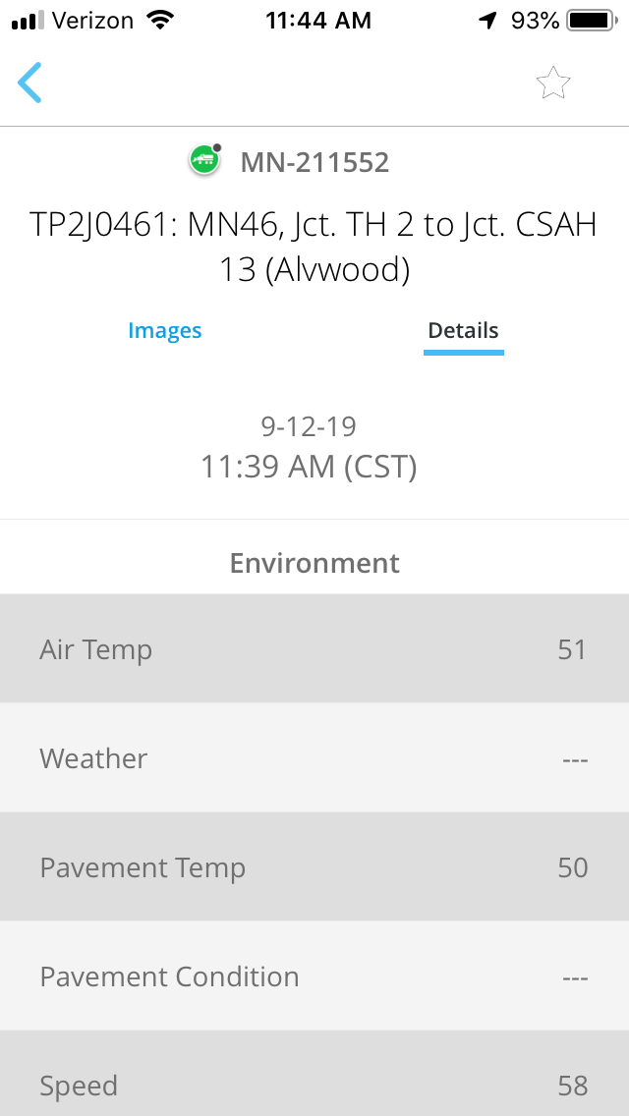
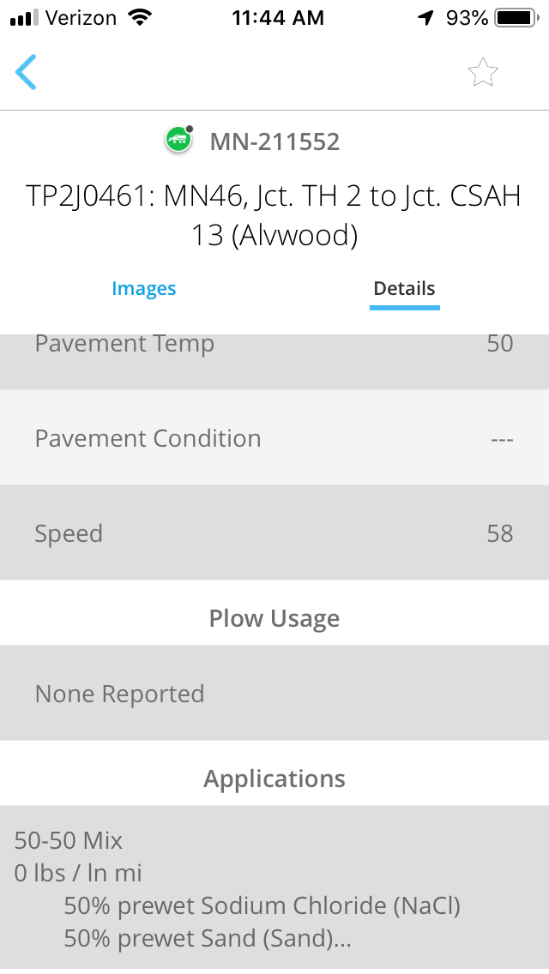
Selecting Observations (Trucks)

Slide 14
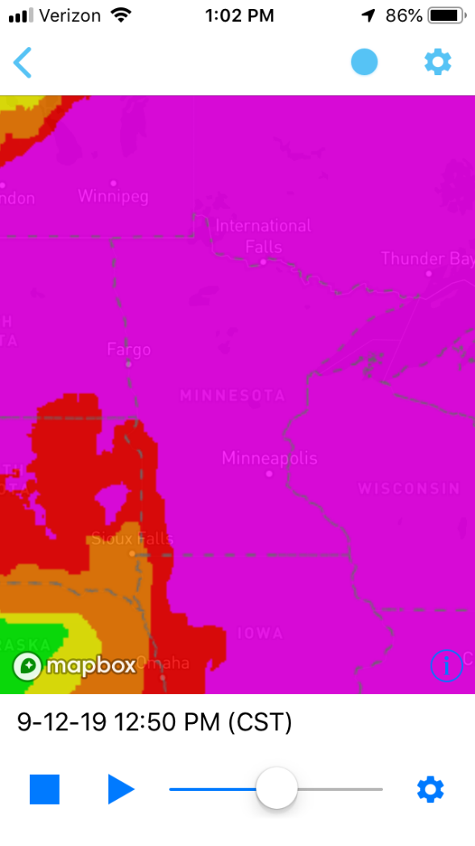
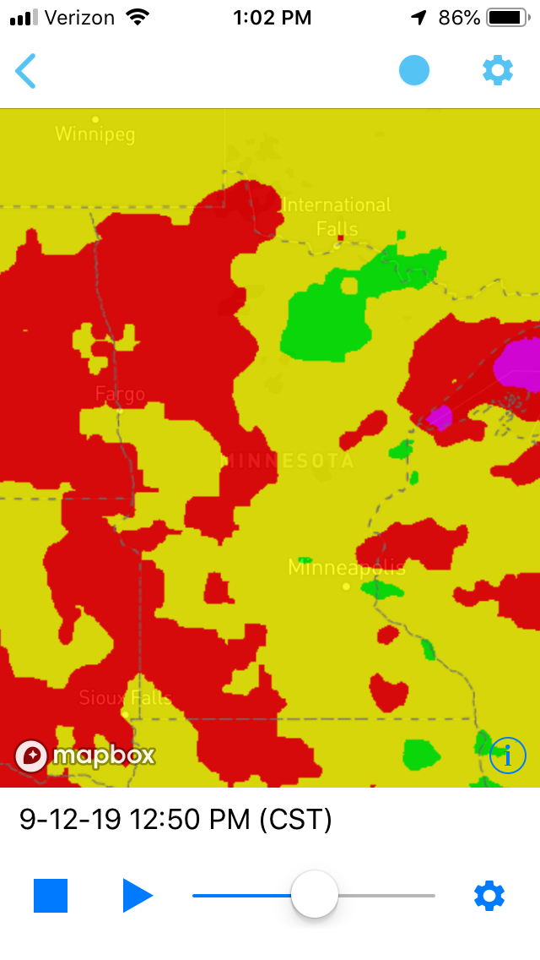
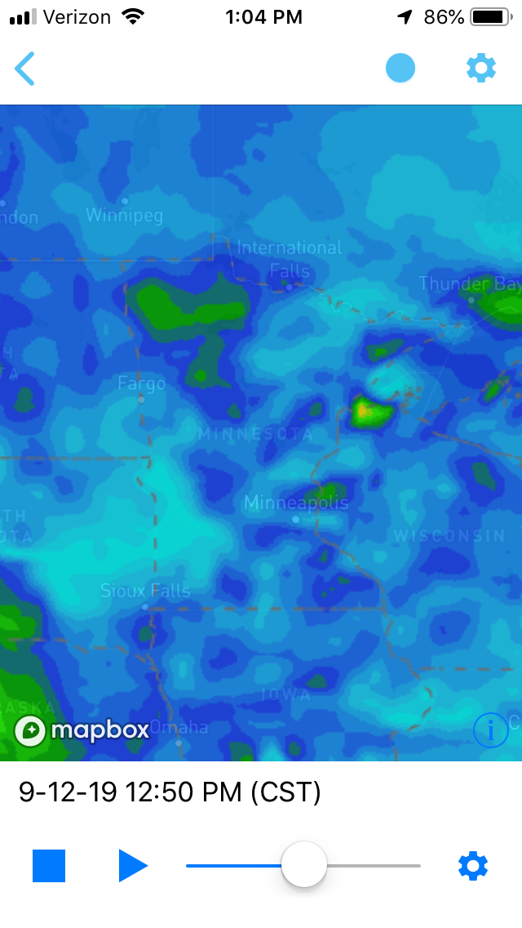
Other Overlay View
Precipitation Probability
Forecasted Winds
Current Winds
Notes:
Explain that these are just a few of the possible overlay selections.

